Slide 1
Exploration
Exploitation
Dilemma
Online decision-making involves a fundamental choice:
→Exploitation Make the best decision given current information
→Exploration Gather more information
The best long-term strategy may involve short-term sacrifices
Gather enough information to make the best overall decisions

Slide 2
Exploration
Exploitation
Dilemma
Restaurant Selection
→Exploitation Go to your favorite restaurant
→Exploration Try a new restaurant
Online Banner Advertisements
→Exploitation Show the most successful advert
→Exploration Show a different advert
Game Playing
→Exploitation Play the move you believe is best
→Exploration Play an experimental move

Slide 3
Exploration
Exploitation
Dilemma
1. Random exploration
→ Explore random actions( e.g. $ε$-greedy, softmax)
2. Optimism in the face of uncertainty
→ Estimate uncertainty on value
→ Prefer to explore states/actions with highest uncertainty
3. Information state space
→ Consider agent’s information as part of its state
→ Lookahead to see how information helps reward

Slide 4
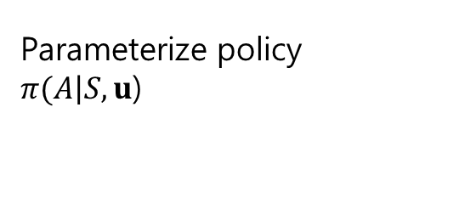
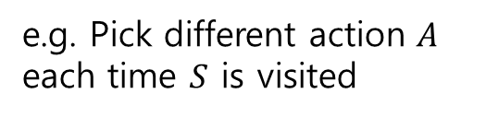
State-action
Exploration
Parameter
Exploration
State-action Exploration
Parameter Exploration
Systematically explore
state space / action space
Parameterize policy
$π(\left.A\right|S, u$)
e.g. Pick different action $A$ each time $S$ is visited
e.g. Pick different parameters and try for a while
Advantage: consistent exploration
Disadvantage: doesn’t know about
state/action space We will focus on
state-action exploration

Slide 5

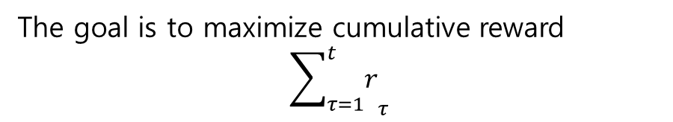
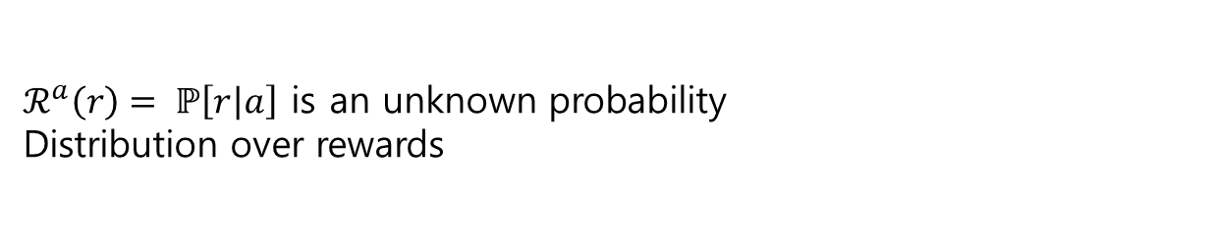
The
Multi
Armed
Bandit
MAB(the Multi-Armed Bandit)
A multi-armed bandit is a tuple $\left\langle 𝒜, ℛ\right\rangle$
$𝒜$ is a known set of m actions(or “arms”)
$ℛ^{a}\left(r\right)= ℙ\left[\left.r\right|a\right]$ is an unknown probability
Distribution over rewards
At each step t the agent selects an action $a_{t}∈𝒜$
The environment generates a reward $r_{t} \sim ℛ^{at}$
The goal is to maximize cumulative reward
$${\sum_{τ=1}^{t}{r}}_{τ}$$

Slide 6
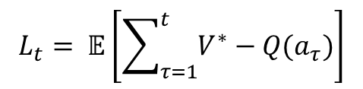
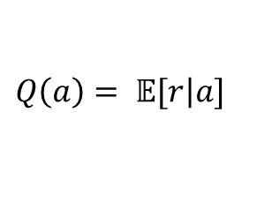
Regret
The action-value is the mean reward for action a,
$$Q\left(a\right)= 𝔼[\left.r\right|a]$$
The optimal value $V^{∗}$ is
$$V^{∗}=Q\left(a^{∗}\right)= \max_{a∈A}{Q(a)}$$
The regret is the opportunity loss for one step
$l_{t}= 𝔼[V^{∗}−Q(a_{t})$]
The total regret is the total opportunity loss
$$L_{t}= 𝔼\left[\sum_{τ=1}^{t}{V^{∗}}−Q(a_{τ})\right]$$
Maximize cumulative reward $≡$ minimize total regret

Slide 7



Counting
Regret
The count $N_{t}(a)$ is expected number of selections for action a
The gap$∆_{a}$ is the difference in value between action a and optimal $a^{∗}$,
$∆_{a}$ = $V^{∗}−Q(a)$
Regret is a function of gaps and the counts
$$L_{t}= 𝔼\left[\sum_{τ=1}^{t}{V^{∗}}−Q(a_{τ})\right]$$
$$=\sum_{τ=1}^{t}{𝔼[N_{t}\left(a\right)](V^{∗}−Q\left(a\right))}$$
$$=\sum_{τ=1}^{t}{𝔼[N_{t}\left(a\right)]{ ∆}_{a}}$$
A good algorithm ensures small counts for large gaps
Problem : gaps are not known!

